Slide 1
Discrete Mathematics
Chapter 6
Discrete Probability

Slide 2
Finite Probability
If S is a finite sample space of equally likely outcomes, and E is an event (a subset of S), then the probability of E is p(E) = |E|/|S|
Example: What is the probability that when 2 dice are rolled, the sum of the numbers on the 2 dice is 7?
Solution: There are a total of 36 equally likely possible outcomes when 2 dice are rolled.
There are six successful outcomes, namely, (1, 6), (2, 5), (3, 4), (4, 3), (5, 2) and (6, 1).
Hence the probability that a seven comes up when 2 dice are rolled is 6/36 = 1/6.

Slide 3
Finite Probability
Example: In a lottery, players win a large prize when they pick four digits that match in the correct order, four digits selected by a random process. A smaller prize is won if only three digits are matched. What is the probability that a player wins the large prize? What is the probability that a player wins the small prize?

Slide 4
Finite Probability
What is the probability that Selim, Raju and Faruk win the first, second and third prizes respectively in a drawing if 200 people enter a contest and
No one can win more than one prize.
Winning more than one prize is allowed.

Slide 5
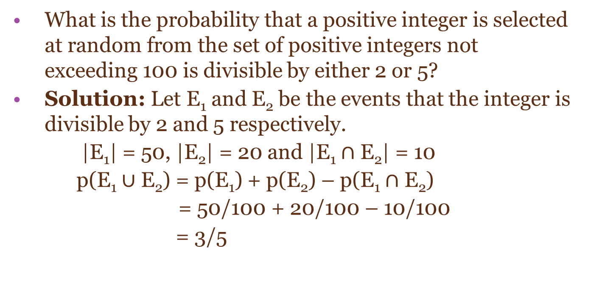
Probability of Combinations of Events
What is the probability that a positive integer is selected at random from the set of positive integers not exceeding 100 is divisible by either 2 or 5?
Solution: Let E₁ and E₂ be the events that the integer is divisible by 2 and 5 respectively.
|E₁| = 50, |E₂| = 20 and |E₁ $∩$ E₂| = 10
p(E₁ $∪$ E₂) = p(E₁) + p(E₂) – p(E₁ $∩$ E₂)
= 50/100 + 20/100 – 10/100
= 3/5

Slide 6
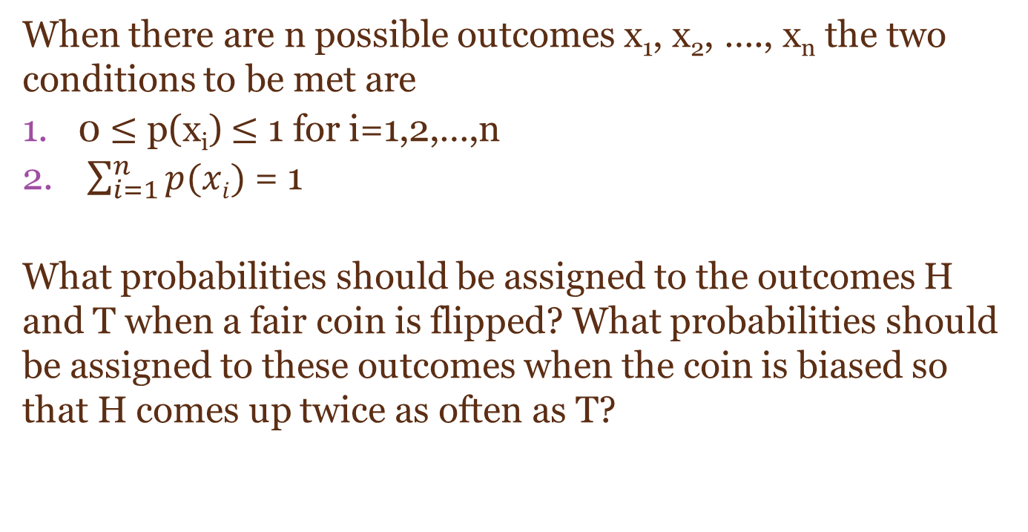
Assigning Probabilities
When there are n possible outcomes x₁, x₂, …., x_{n} the two conditions to be met are
0 $≤$ p(x_{i}) $≤$ 1 for i=1,2,…,n
$\sum_{i=1}^{n}{p(xi)}$ = 1
What probabilities should be assigned to the outcomes H and T when a fair coin is flipped? What probabilities should be assigned to these outcomes when the coin is biased so that H comes up twice as often as T?

Slide 7
Assigning Probabilities
Suppose that a die is biased (or loaded) so that 3 appears twice as often as each other number but the other five outcomes are equally likely. What is the probability that an odd number appears when we roll this die?

Slide 8

Conditional Probability
Let E and F be events with p(F) > 0. The conditional probability of E given F, denoted by p(E|F), is defined as
A bit string of length four is generated at random so that each of the 16 bit strings of length four is equally likely. What is the probability that it contains at least 2consecutive 0’s given that its first bit is a 0?

Slide 9
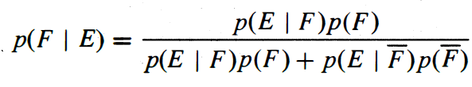
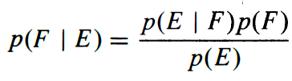
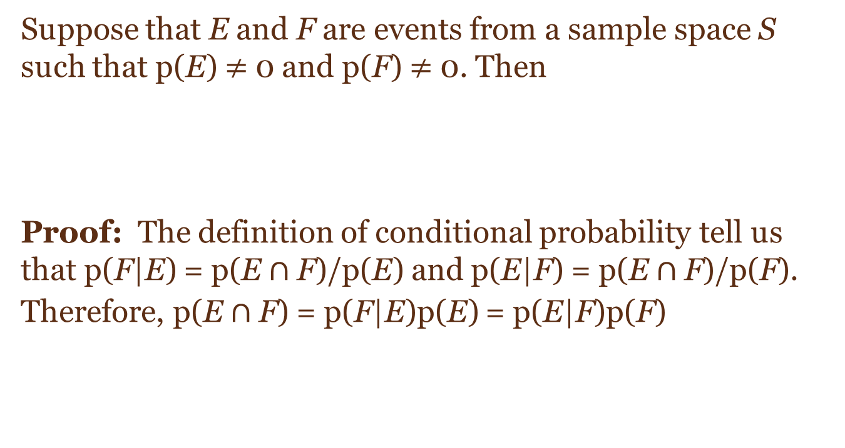
Bayes’ Theorem (VVI)
Suppose that E and F are events from a sample space S such that p(E) $≠$ 0 and p(F) $≠$ 0. Then
Proof: The definition of conditional probability tell us that p(F|E) = p(E$∩$ F)/p(E) and p(E|F) = p(E$∩$ F)/p(F).
Therefore, p(E$∩$ F) = p(F|E)p(E) = p(E|F)p(F)

Slide 10
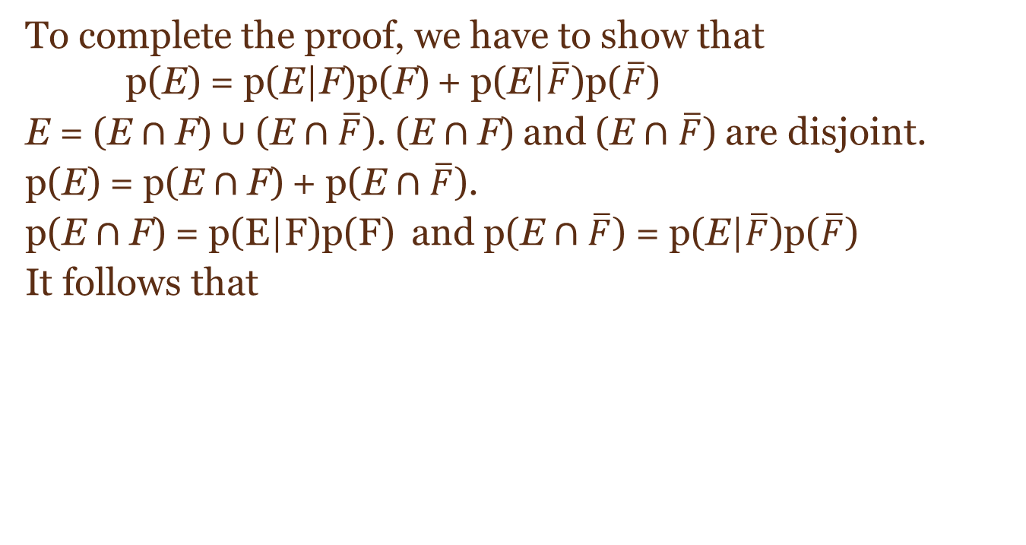
Bayes’ Theorem
To complete the proof, we have to show that p(E) = p(E|F)p(F) + p(E|$\overline{F}$)p($\overline{F}$)
E = (E$∩$F) $∪$ (E$∩$ $\overline{F}$). (E$∩$F) and (E$∩$ $\overline{F}$) are disjoint.
p(E) = p(E$∩$F) + p(E$∩$ $\overline{F}$).
p(E$∩$F) = p(E|F)p(F) and p(E$∩$ $\overline{F}$) = p(E|$\overline{F}$)p($\overline{F}$)
It follows that

Slide 11
Bayes’ Theorem
Suppose that one person in 100000 has a particular rare disease for which there is a fairly accurate diagnostic test. This test is correct 99% o the time when given to someone with the disease; it is correct 99.5% of the time when given to someone who does not have the disease. Given the information can we find
The probability that someone who tests positive for the disease has the disease?
The probability that someone who tests negative for the disease does not have the disease?

Slide 12
HW------→
Boiyer seser example korte bhobe

